Slide 1
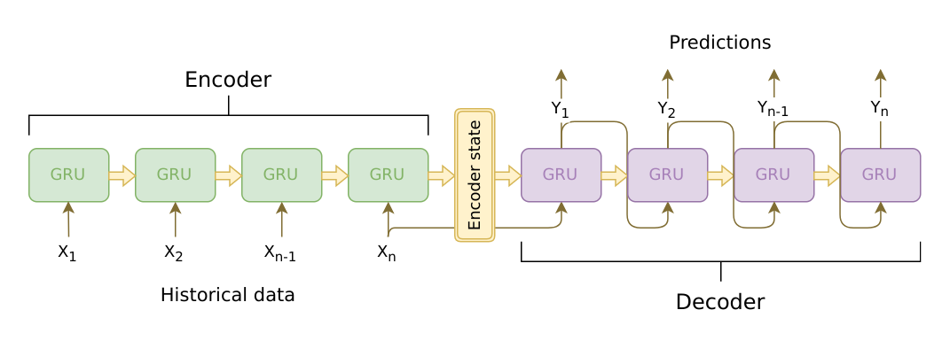

Teacher Forcing Rate =0.5
$$\left[Y_{1},X_{2}\left[1:\right],h_{1}\right]$$

Slide 2
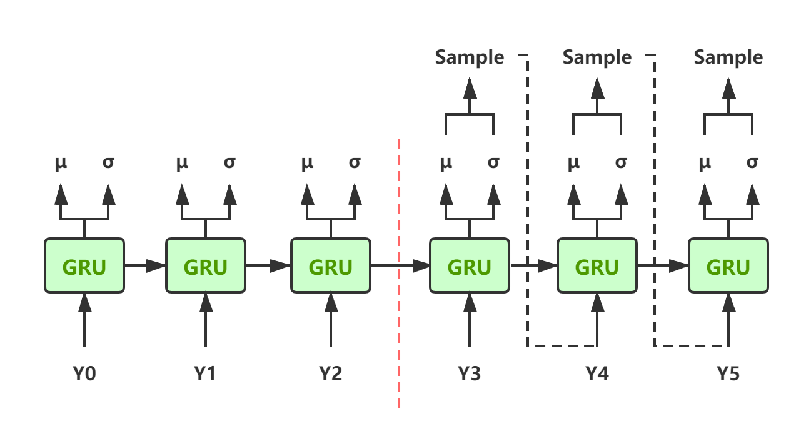



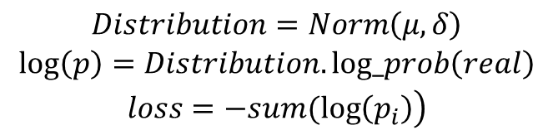
Loss Function: is vector of every decoder step
$$\left(μ,δ\right)$$
Deep AR = Deep Auto Regressive
$$\begin{matrix}Distribution=Norm\left(μ,δ\right) \\ log\left(p\right)=Distribution.log_prob\left(real\right) \\ \left.loss=−sum(log\left(p_{i}\right)\right)\end{matrix}$$
$$i$$
= Decoder Length
Same Model between Encoder and Decoder
$$\left[sample_{4},X_{4}\left[1:\right]\right]$$

Slide 3
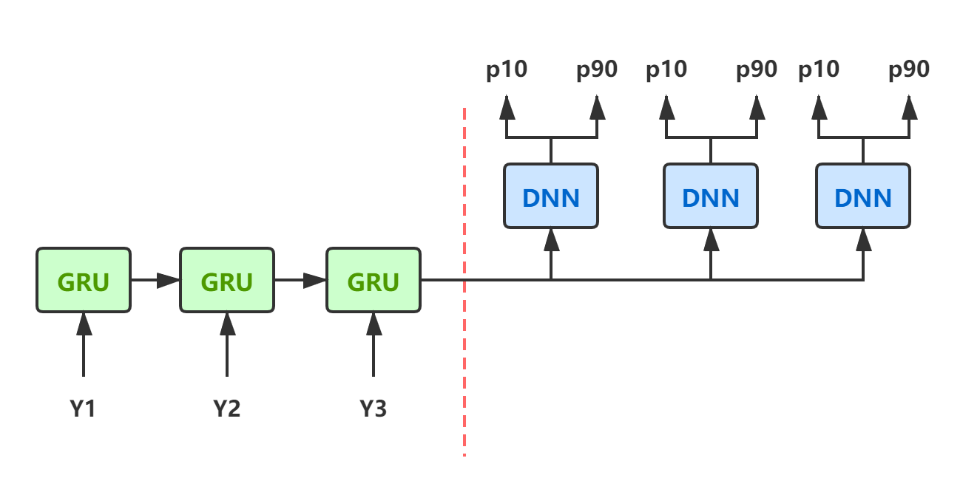
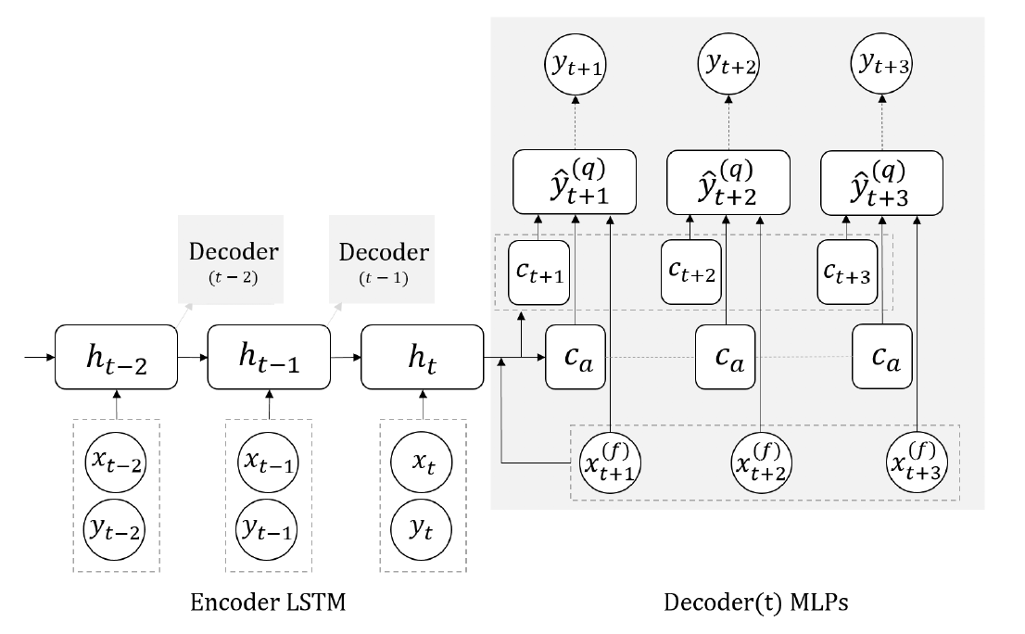


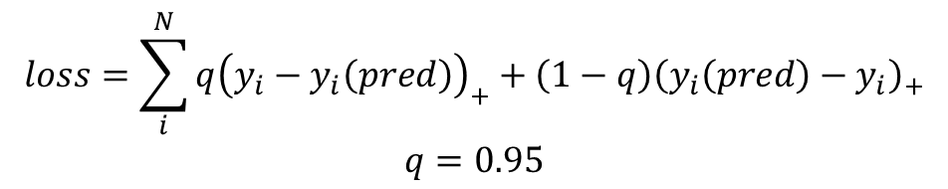
$$\begin{matrix}loss=\sum_{i}^{N}{q{\left(y_{i}−y_{i}\left(pred\right)\right)}_{+}}+\left(1−q\right){\left(y_{i}\left(pred\right)−y_{i}\right)}_{+} \\ q=0.95\end{matrix}$$
MQRNN ---- Multiple-Quantile RNN
Global MLP:
Local MLP:

Slide 4
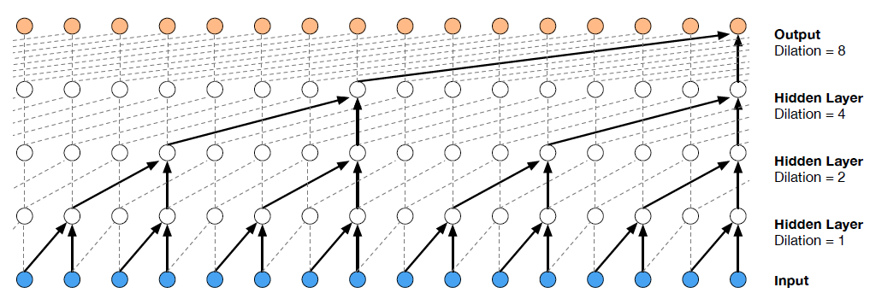


Wave Net
These two predictions must be deleted
So needs causal convolution dilated
Dilation = 2
Filter =
$$\left[:,:,:−padding\right]$$
Tanh()
Padding = (Kernel size - 1) * Dilation
Gated =
$$\left[:,:,:−padding\right]$$
ReLU()

Slide 5
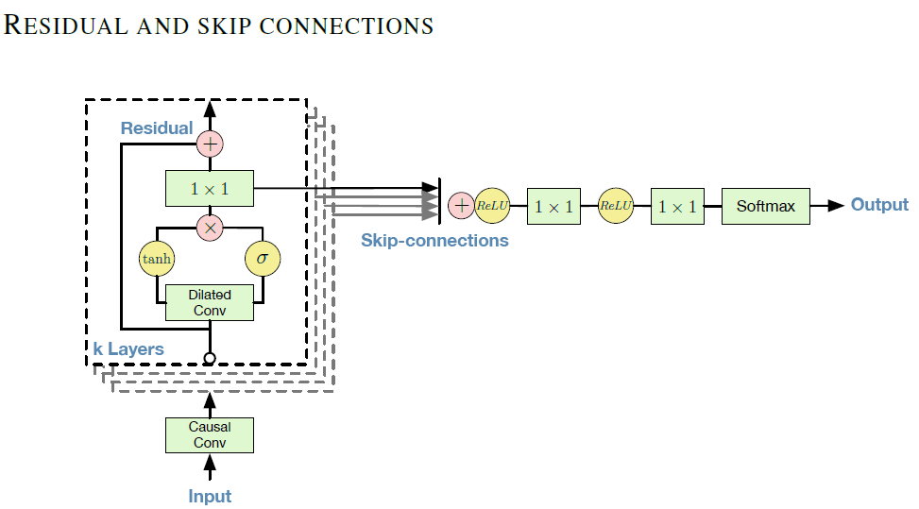
teacher forcing rate:
Train Step: teaching every step
Test Step: no teaching
Algorithm Detail:
For x in Stack:
Step 1: inputs --> Dense Conv
Step 2: Dense Conv --> Dilated Conv
Step 3: inter = Dense Conv(Tanh(Dilated Conv) * ReLU(Dilated Conv))
Step 4: Residual: output = inputs + inter
Step x: Sum(Residual)
Step x1: Final output = (Dense Conv + drop + Dense Conv)(Sum(Residual))

Slide 6
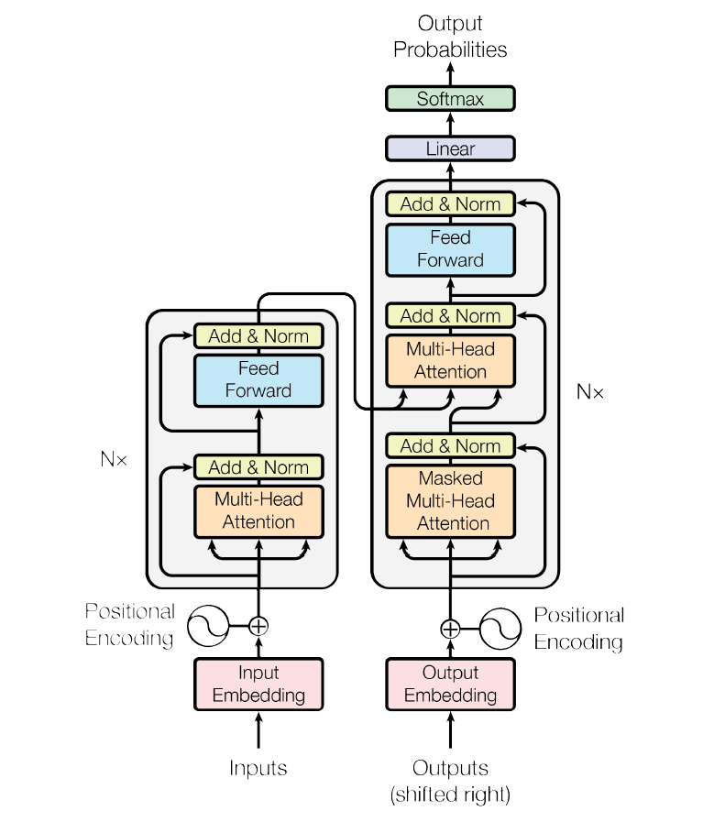

Slide 7
Encoder
Decoder
Outputs
Outputs
Outputs
Outputs
Same parameters
Same parameters
Same parameters
Same parameters
Inputs
Inputs
Inputs
Inputs
Predict 1
Predict 2
Train Part: 1. 全程Teacher forcing，不填充inputs；2. 对所有time step进行train(Total step: 155);
Test Part: 1. 在decoder部分，teacher forcing = None；2. 随着预测的时间越靠后，predict的step数据更多;
Mask: torch.tril(torch.zeros(time_step, time_step)) 只取下三角数据为1点，Tensor.masked_fill(mask==0, -1e10)

